Slide 1
Little Racers
Pitch Date: June 22 , 2019
Release Date: September 15, 2019
Team Lead: Vince McKeown

Slide 2
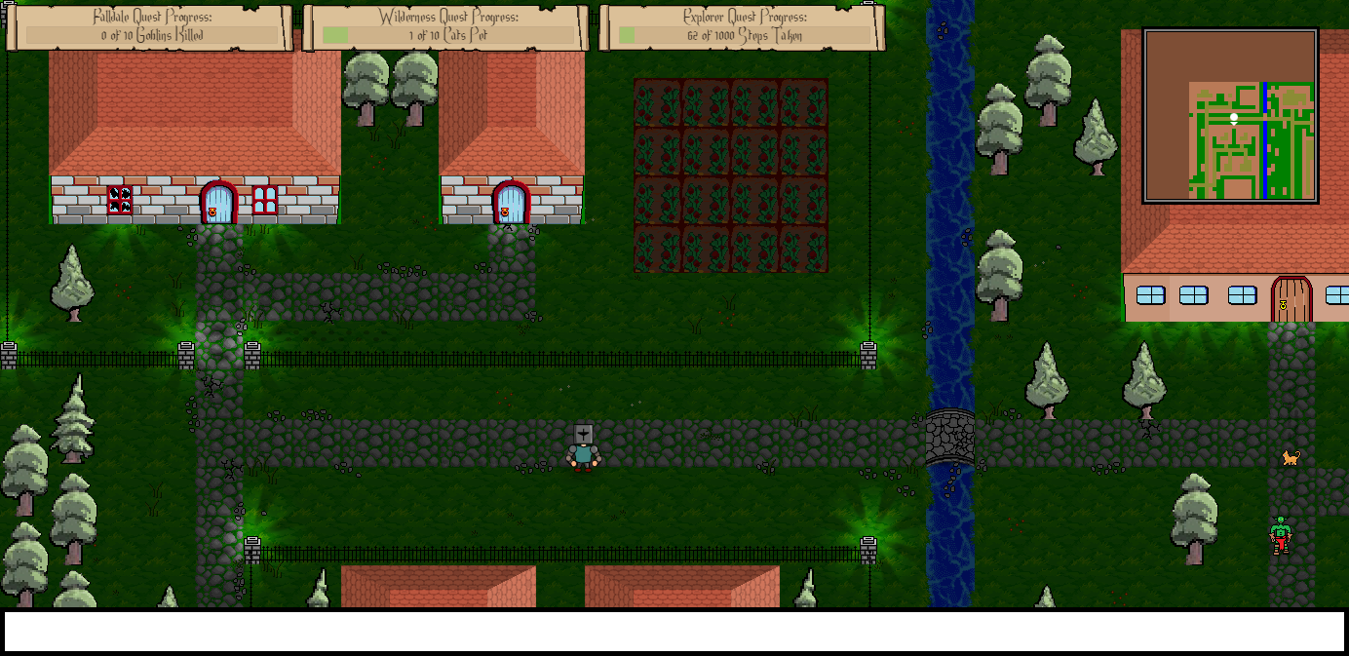
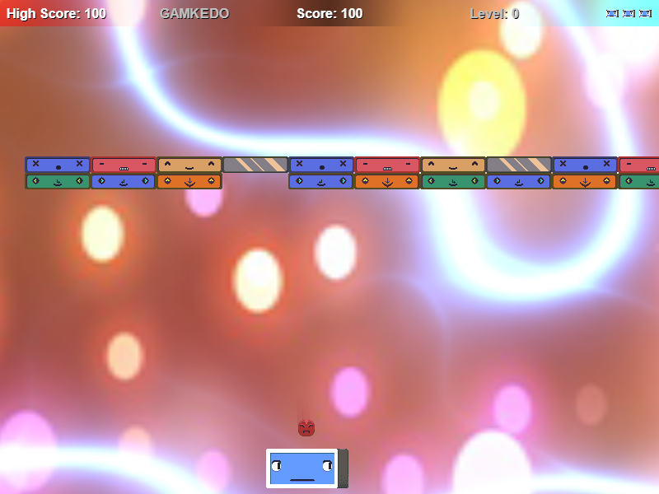


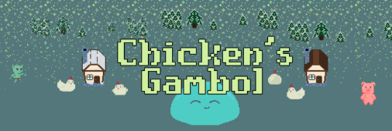

Prior Club Experience
Falldale
Ballrog
Game Changer
Art for grass, dirt, house and buildings (including damaged and destroyed states), goblin sprite integration
Ground enemy sprite
Debug coding, player inputs,
refactoring, reset function,
Audio code, pause, mute, animation
Logic for Sprite Sheet

Slide 3
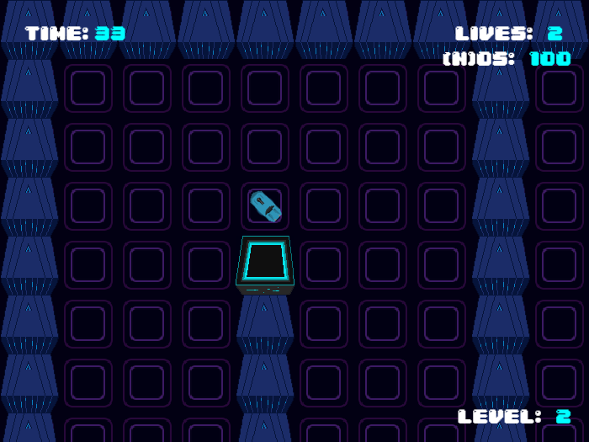
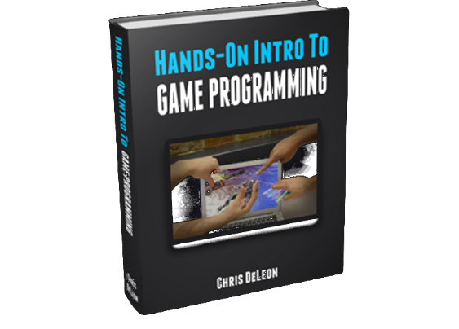
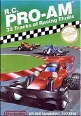
Related Games
Clash-Tracks
Turbo Racing
RC Pro-Am

Slide 4
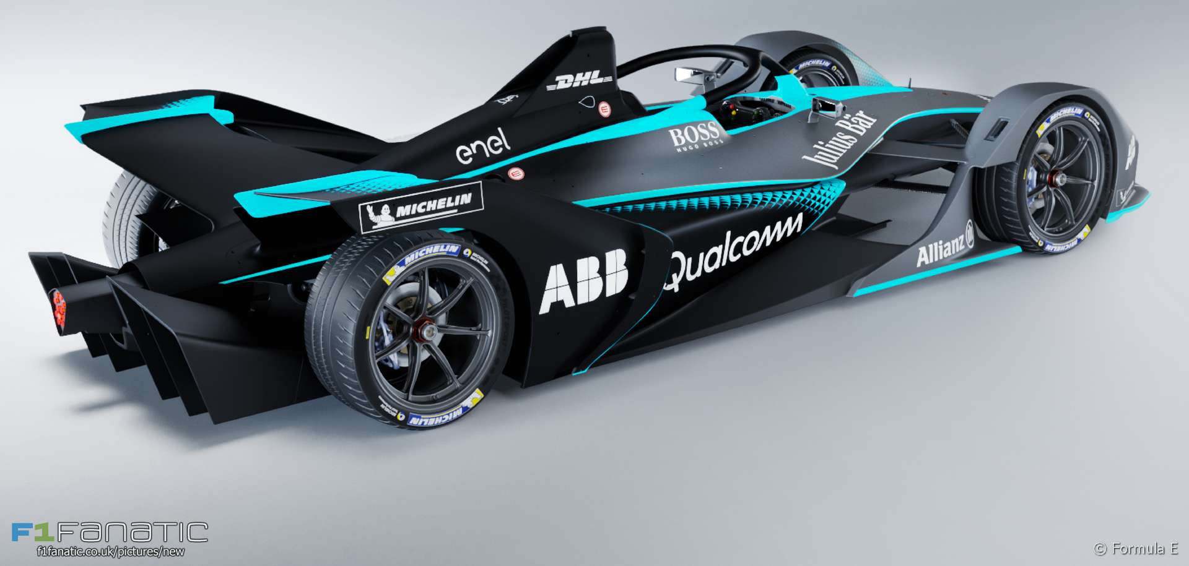
Demo
Cutover to Game

Slide 5

Vision
Player sense of achievement
Good AI
Car Race Season
Keeping it fun and creative

Slide 6
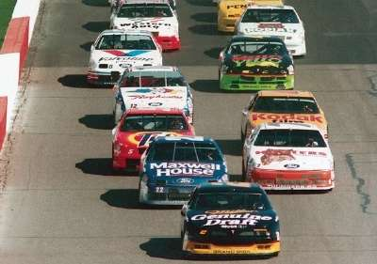
Schedule
Cutover to Trello

Slide 7
Roles
Art:
Special Effects: Cars catching fire
Track Objects: Bridges, obstacles
Environmental Art: Buildings, trees, dessert scenes
Sounds:
Ready, Set, Go!
Vrooom, Vrooom!
Crash!
Background music

Slide 8
Roles
Code:
Level Editor.
Artificial Intelligence.

Slide 9
Questions?
Who is ready to race?

